Slide 1
Black Nationalism through the World System Lens: A Legacy of Rod Bush
A Tribute to Rod Bush
Warrior for Justice Part I: The Integration of Ideas and Practice
Monday, August 18, 2014 – The San Francisco Marriot Marquis
By
James V. Fenelon
California State University, San Bernardino & Lakota Oyate

Slide 2
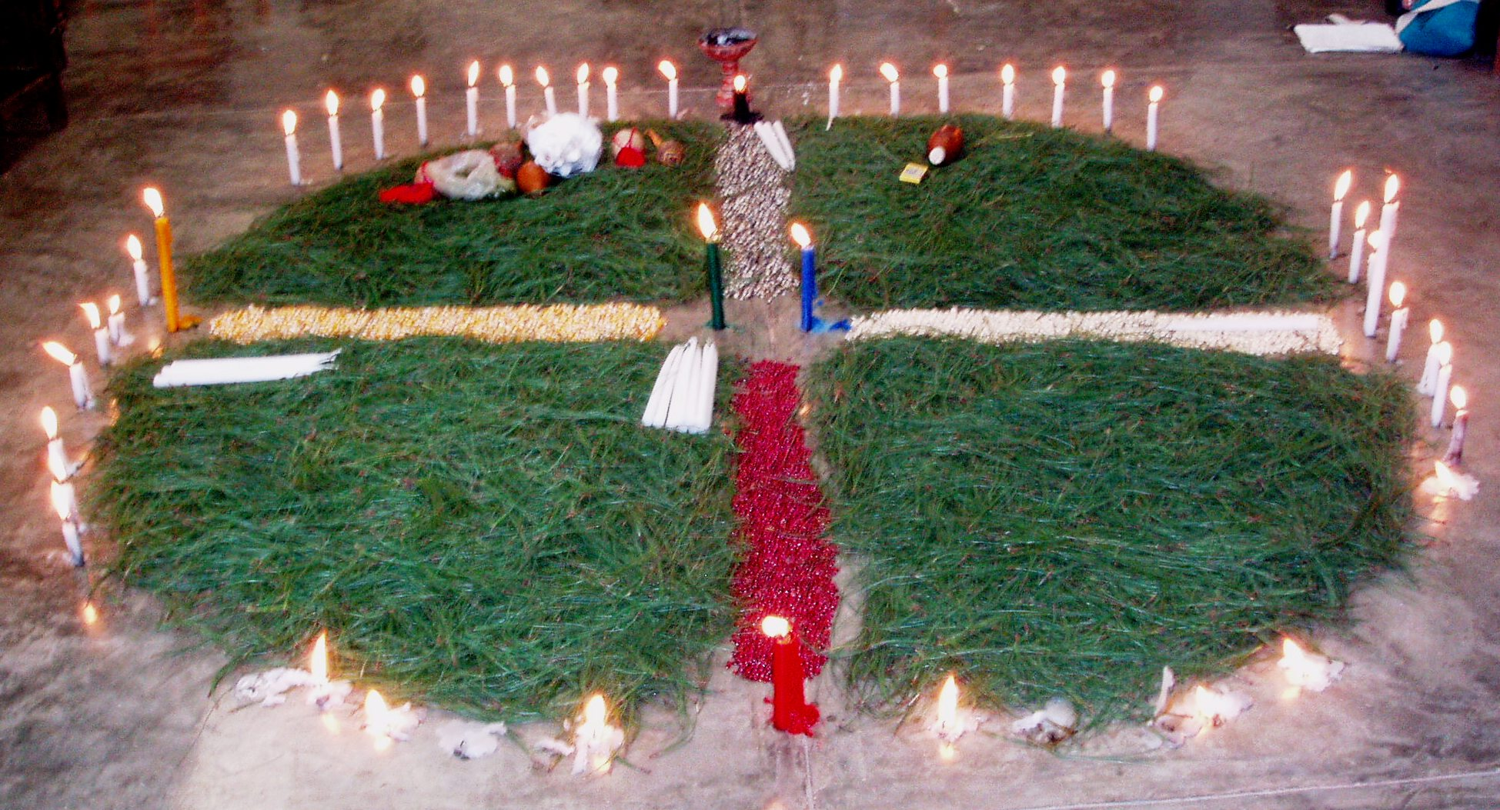
Plate 7.4 Mayan traditional cross

Slide 3
AKICITA SAPA OYATE
First memories of Rod Bush were at an ASA in San Francisco
Large room, big ideas, and a few people
We moved the discussion off the dais unto the floor
Where we engaged the group in the ideas
I spoke to “Framing Wounded Knee – 1890 to 1973 to 1990
Rod spoke to the creation of Black Nationalism in the U.S.
Ethno-national struggles – surviving and thriving in Amerika

Slide 4
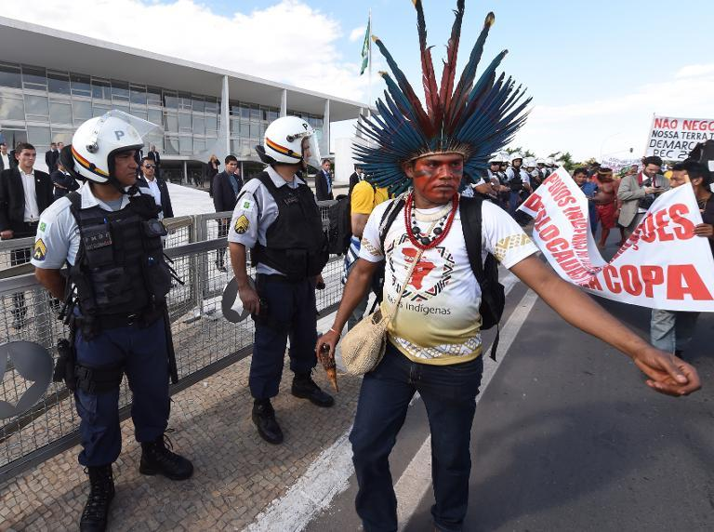
Brazilian natives protest Planalto palace, May, 2014

Slide 5
Ethno-national struggles
Native Nations – the telling of our stories, struggles
Black Nationalism and the Civil Rights Movement
Modern world system and capitalism bourne by and into the genocidal destruction of indigenous peoples and massive enslavement of peoples stolen from societies and nations in Africa – both in many millions
Hegemonic dominance and the suppression of these origin stories – the “Indian” and the “Black”

Slide 6
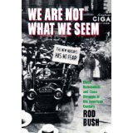
Black Nationalism and Class Struggle
We Are Not What We Seem: Black Nationalism and Class Struggle in the American Century
by Roderick D. Bush
(2000)

Slide 7
INTELLECTUALISM & POSITIVE IMAGERY
Black Intellectuals – from Fanon and DuBois to Contemporary Perspectives
Ideological analysis – understanding the World-System hegemonic ideologies versus resistance ideologies
Merging colonialism and “post-” colonialism thought, maintaining focus on racist and supremacist thinking
Being positive in seeing “an ending” to the White World Supremacy of global racism and historical capitalism

Slide 8
Social Movement Leadership produces change and progress (within U.S. national constructs)
(international marginalization)

Slide 9
LITERATE – JUSTICE ACTIVIST – ANTI-RACIST
Literatures woven together – in the world systems analysis and radical Black social movement history traditions
Some of my greatest regrets were not responding to, or at least being able to respond to the generous and thoughtful invitations by Professor Rod Bush to engage with the many “radical” and “social justice” organizations and conferences which he was engaged with, on so many levels
Testimony to the “Social Activism” and Deep Commitment which any such Warrior must bring all one’s actions

Slide 10
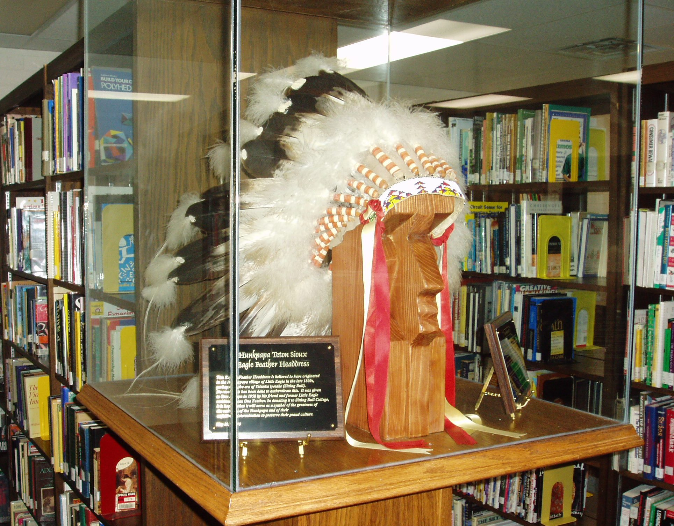
Plate 5.6 Eagle Headdress, S.R.

Slide 11

Going global – taking on Supremacists
The End of White World Supremacy: Black Internationalism and the Problem of the Color Line
by Roderick Bush
(Jul 28, 2009)

Slide 12
HONORING OF A PASSING WAY TOO SOON
The Gaelic-Irish way to recognize such a passing is through a “Wake” that originates from Awakening, Remembering the man and the spirit
The Lakota-Sioux way to recognize a spiritual journey to the Earth and Milky Way, is Pilamaya for an Akicita, a warrior, and Wopila for his Good Deeds in Honor
“pilamaya” – “wopila”

Slide 13
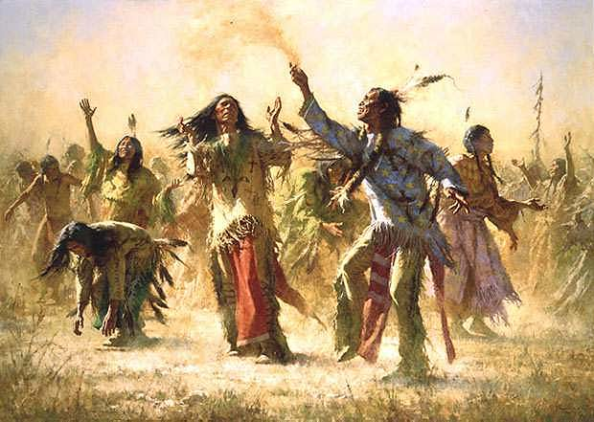
Calling on the Spirits

